Slide 1


DOM – Document Object Model
copyright 2009 trainologic LTD

Slide 2

DOM
Document Object Model
Handling Events
Built-in classes and objects
44
copyright 2009 trainologic LTD

Slide 3

Javascript
DOM
DOM is a standard (by W3C) for accessing documents such as HTML and XML.
It defines the different objects in the document in the following way:
Node
Document
Element
Attr
Entity
CharacterData
NodeList
Text
Comment
NamedNodeMap
CDATASection
DocumentType
50
copyright 2009 trainologic LTD

Slide 4
Javascript
DOM
  The entire document is a document node .
  HTML tags are element nodes.
  The text in the element is a text node.
  Every attribute is an attribute node.
  Comments are comment nodes.
Node
Document
Element
Attr
Entity
CharacterData
NodeList
Text
Comment
NamedNodeMap
CDATASection
DocumentType
51
copyright 2009 trainologic LTD

Slide 5
Javascript
Example
The DOM is a tree representation of our HTML document.
See the following example:
<html>
<head>
<title>Pets R Us</title>
</head>
<body>
<h1>We sell Pets</h1>
<img src="pic1.jpg"/>
</body>
</html>
Element: html
Element: body
Element: head
Element: h1
Element: img
Element: title
Text: We sell…
Attr: name: src
value:pic1.jpg
Text: Pets R Us
52
copyright 2009 trainologic LTD

Slide 6
Javascript
DOM Node’s Properties
Every node in the DOM tree supports the following attributes:
e.parentNode - the parent node of e.
e.childNodes - the child nodes of e.
e.attributes - the attributes nodes of e.
e.innerHTML - the inner text value of e.
53
copyright 2009 trainologic LTD

Slide 7
Javascript
DOM Node’s Properties
More attributes:
e.nodeName – read-only, the name of e.
For element – the tag name.
For attribute – the attribute name.
For text - #text.
e.nodeValue - the value of e.
For element – undefined.
For attribute – the attribute value.
For text – the text itself.
e.nodeType
The most useful types:
1 – element, 2 – attribute, 3 – text.
54
copyright 2009 trainologic LTD

Slide 8
Javascript
DOM Node’s Methods
Every node in the DOM tree supports the following methods:
e.getElementById(id) - get the element
with a specified id under e.
e.getElementsByTagName(name) – get all elements
of a specified tag under e.
e.appendChild(node) – adds a child node.
e.removeChild(node) – removes a child node.
55
copyright 2009 trainologic LTD

Slide 9
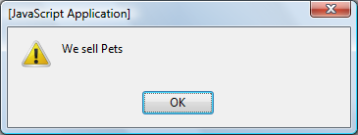
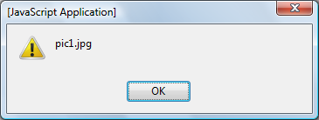
Javascript
Moving in the Tree
Accessing elements by the tree structure:
  Note that the “\n”s are represented in the tree.
<html>
<head>
<title>Pets R Us</title>
<script type="text/javascript">
function initSelf() {
alert(document.documentElement.childNodes[1].childNodes[1]
.firstChild.nodeValue);
alert(document.documentElement.childNodes[1].childNodes[3]
.attributes[0].nodeValue);
{
</script>
</head>
<body onload="initSelf()">
<h1>We sell Pets</h1>
<img src="pic1.jpg"/>
</body>
</html>
56
copyright 2009 trainologic LTD

Slide 10
Javascript
HTML DOM
The HTML DOM defines a standard set of objects for HTML, and a way to access and manipulate HTML elements.
Here is a partial list of the objects:
  Document - used to access all elements in a page
  Anchor - Represents an <a> element
  Image Represents an <img> element
  Table Represents a <table> element
  TableData Represents a <td> element
  TableRow Represents a <tr> element
57
copyright 2009 trainologic LTD

Slide 11
Javascript
HTML DOM
More objects:
  Form Represents a <form> element
  Input text Represents a textbox
  Input button Represents a button
  Textarea Represents a <textarea> element
  Frame Represents a <frame> element
58
copyright 2009 trainologic LTD

Slide 12
Javascript
innerHTML
Using the innerHTML attribute you may alter the content of an element.
  This means that you create new elements on the fly.
function changeLink(){
document.getElementById('myLink').innerHTML="<b>Go Now</b>";
document.getElementById('myLink').href="http://www.w3schools.com";
{
<a id="myLink" href="http://www.google.com" onmouseover="changeLink()"">Go Search</a>
59
copyright 2009 trainologic LTD

Slide 13
Javascript
The Document
Represents the entire document, here are some useful methods and attributes:
var txt = document.getElementById("myTxt");
txt.innerHTML = "<b>Halo</b>"
var divs = document.getElementsByTagName("div");
var images = document.images;
var forms = document.forms;
alert(divs.length);
60
copyright 2009 trainologic LTD

Slide 14


Javascript
Switching the Element’s Class
One useful technique to create a responsive GUI is to handle the mouse events:
<style>
.nav {
border: 1px gray solid;
width: 100px;
{
.navHover {
border: 2px green solid;
cursor: pointer;
width: 100px;
{
</style>
function switchMyClass(e) {
if (e.className == "navHover")
e.className = "nav";
else e.className = "navHover";
{
<div class="nav" onmouseover="switchMyClass(this)"
onmouseout="switchMyClass(this)">
Go Fetch
</div>
61
copyright 2009 trainologic LTD

Slide 15
Javascript
Hiding/Showing Elements
A common situation is when you need to hide and show a section of your document
function showStuff(id) {
document.getElementById(id).style.display = 'block';
}
function hideStuff(id) {
document.getElementById(id).style.display = 'none';
}
62
copyright 2009 trainologic LTD

Slide 16
Javascript
The Text Object
Represents a textbox:
var txt = document.getElementById("txt");
txt.value = "Muki";
txt.maxLength = 10;
txt.readOnly = true;
txt.focus();
txt.select();
<input id="txt" />
63
copyright 2009 trainologic LTD

Slide 17


Javascript
The Image Object
Represents an Image:
setInterval("switchImage()", 2000);
var IMG1 = "pic1.jpg";
var IMG2 = "pic2.jpg";
var gSelectedImg = IMG1;
function switchImage() {
if (gSelectedImg == IMG1) gSelectedImg = IMG2;
else gSelectedImg = IMG1;
document.getElementById(“myImg").src = gSelectedImg;
{
<img id=“myImg" src="pic1.jpg" />
64
copyright 2009 trainologic LTD

Slide 18
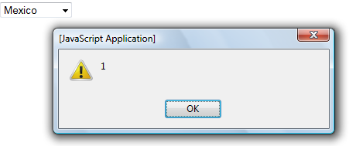
Javascript
The Select Object
Represents a combo box.
function echoCountry() {
countries = document.getElementById("country");
alert(countries.selectedIndex);
{
<select id="country" onchange="echoCountry()">
<option>Guatemala</option>
<option>Mexico</option>
<option>Beliz</option>
</select>
65
copyright 2009 trainologic LTD

Slide 19
Javascript
Everything is in the DOM
We saw several examples for objects representing elements in the page.
Remember that everything is in the DOM, so its very easy to access and manipulate any section of your page.
66
copyright 2009 trainologic LTD

Slide 20
DOM
Document Object Model
Handling Events
Built-in classes and objects
44
copyright 2009 trainologic LTD

Slide 21
Javascript
Events
Javascript is usually used to react to events.
Here are some examples:
  The Page finished loading.
  Mouse click.
  The user selected something (e.g. option in a list box).
  Keystroke in a textbox.
  Mouse hovering over an element.
Have a look at the following HTML code:
<body onload="initSelf()">
Your name: <input type="text" id="userName" onkeyup="echoInput()" />
<input type="button" value="Do It!" onclick="confirmAndDo()" />
<div id="echoArea" style="color:green" ></div>
</body>
45
copyright 2009 trainologic LTD

Slide 22

Javascript
Events
The following JS functions handle the events.
  It is safe to refer to elements only after the document has loaded, so we used the onload event to focus on an element.
  We see here the document object, we will examine it more closely later:
function initSelf() {
var txtUserName = document.getElementById("userName");
txtUserName.focus();
{
function echoInput() {
var txtUserName = document.getElementById("userName");
var divEchoArea = document.getElementById("echoArea");
divEchoArea.innerHTML = txtUserName.value;
}
46
copyright 2009 trainologic LTD

Slide 23
Javascript
More Events
Event | Occurs | Usage
onunload | The user left the page (e.g., via a link) | Unload resources
onFocus | The field got focus
onBlur | The field lost focus
onChange | The field was change | Form element validation
onSubmit | The submit button was clicked | Entire form validation
onMouseOver | The mouse entered the area of the element | Give the user an indication that he’s on a hot spot
onMouseOut | The mouse has left the area of the element | Change the mouse cursor to regular arrow
47
copyright 2009 trainologic LTD

Slide 24

Javascript
Events
There are many different events you can code.
We will see more events examples in the following slides.
48
copyright 2009 trainologic LTD

Slide 25
DOM
Document Object Model
Handling Events
Built-in classes and objects
44
copyright 2009 trainologic LTD

Slide 26
Javascript
Built-in Classes and Objects
Javascript supplies some built-in classes for your use:
  String, Date, Array, Math, etc.
Javascript comes with several pre-initialized objects to interact with the environment:
  window, document, location, etc.
Lets examine some of them closely.
31
copyright 2009 trainologic LTD

Slide 27

Javascript
The Date Object
Javascript supplies a strong Date object, inspired by the Java Date Object.
Lets see some of its power.
33
copyright 2009 trainologic LTD

Slide 28
Javascript
The Date Object
The following code shows a clock:
function initSelf() {
var today = new Date();
var h= today.getHours();
var m= today.getMinutes();
var s= today.getSeconds();
// add leading zeros
m = formatTime(m);
s = formatTime(s);
document.getElementById('showTime').innerHTML = h+":"+m+":"+s;
window.setTimeout('initSelf()',400);
{
function formatTime(n) {
if (n<10) n = "0" + n;
return n;
{
34
copyright 2009 trainologic LTD

Slide 29

Javascript
Manipulating Dates
The following code checks whether my birthday already occurred in the current year.
  Note that the month starts from 0, so 8 is September.
var now = new Date();
var myBirthday = new Date();
var inOneWeek = new Date();
myBirthday.setFullYear(now.getFullYear(), 8, 24);
inOneWeek.setDate(now.getDate()+5);
if (now > myBirthday) {
alert('After Birthday');
} else if (inOneWeek > myBirthday ) {
alert('Get Ready, birthday in 5 days');
} else {
alert('Before Birthday');
}
35
copyright 2009 trainologic LTD

Slide 30


Javascript
Math
Use the Math static methods to do mathematical calculations:
  max receives an array of numbers.
  random returns a real number between 0-1.
document.write("PI: " + Math.PI + "<br/>");
document.write("Random: " + Math.random() + "<br/>");
document.write(Math.pow(2, 10) + "<br/>");
document.write(Math.max(7, 9, 2) + "<br/>");
document.write(Math.round(7.51) + "<br/>");
39
copyright 2009 trainologic LTD

Slide 31
Javascript
The Window
Represents the browser window, used for:
  Getting access to the URL (Location), the previous browsed pages (History), etc.
  Setting timeouts and intervals.
  Opening popup windows.
  window is the default object, it can be used without specifying its name.
var popup = window.open('','','width=100,height=80')
popup.document.write("a Popup")
popup.focus()
40
copyright 2009 trainologic LTD

Slide 32
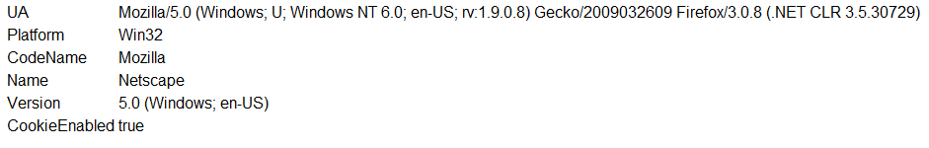
Javascript
Using the Navigator
Get information about the user’s browser and OS:
var n = navigator;
document.write("<table>");
document.write("<tr><td>UA</td><td>" + n.userAgent + "</td></tr>");
document.write("<tr><td>Platform</td><td>" + n.platform + "</td></tr>");
document.write("<tr><td>CodeName</td><td>" + n.appCodeName + "</td></tr>");
document.write("<tr><td>Name</td><td>" + n.appName + "</td></tr>");
document.write("<tr><td>Version</td><td>" + n.appVersion + "</td></tr>");
document.write("<tr><td>Cookies?</td><td>" + n.cookieEnabled+ "</td></tr>");
document.write("</table>");
41
copyright 2009 trainologic LTD

Slide 33
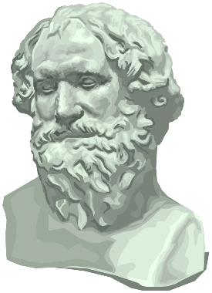
Javascript
History
Using the history object it is possible to simulate a click on the next/previous buttons.
<input type="button" value="Go Back" onclick="window.history.go(-1)“ />
42
copyright 2009 trainologic LTD

Slide 34

Javascript
Location
The Location object holds information about the current URL:
alert(location.hostname);
43
copyright 2009 trainologic LTD

Slide 35
Javascript
Summary
Javascript is the leading scripting language for the web.
Use Javascript to:
  Code HTML events,
  Create a dynamic and responsive GUI,
  Dynamically manipulate your HTML elements.
HTML documents are available as DOM, defining a standard way to access and modify elements.
75
copyright 2009 trainologic LTD

